Slide 1
Introduction to Machine Learning
CCS3102

Slide 2
Evaluations
End of course exams : 70 %
Project : 20 %
Mid Term Assessment : 10 %

Slide 3
This Week
Introduction
What is Machine Learning? (Layman’s Term)
Rule Based vs ML Systems
Learning Paradigms (Supervised, Unsupervised and Reinforcement)
Machine Learning Applications
Setting up development environment for practicals

Slide 4
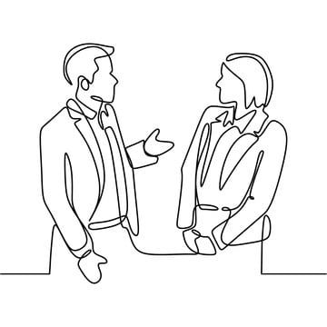

What is Machine Learning?
Humans can learn from their past experiences and make new decisions of their own…
What is this object ?

Slide 5
What is Machine Learning?
Humans can learn from their past experiences and make new decisions of their own…
It is a car

Slide 6



What is Machine Learning?
Let’s ask the same question at Tarzan, Naruto and a newborn baby?
What is this object ?
Do you think they can answer it?

Slide 7

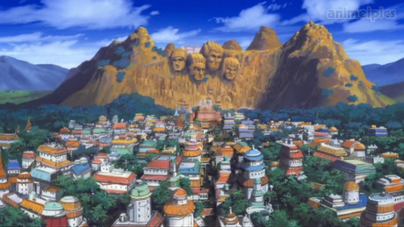

What is Machine Learning?
Certainly they cannot, because…

Slide 8
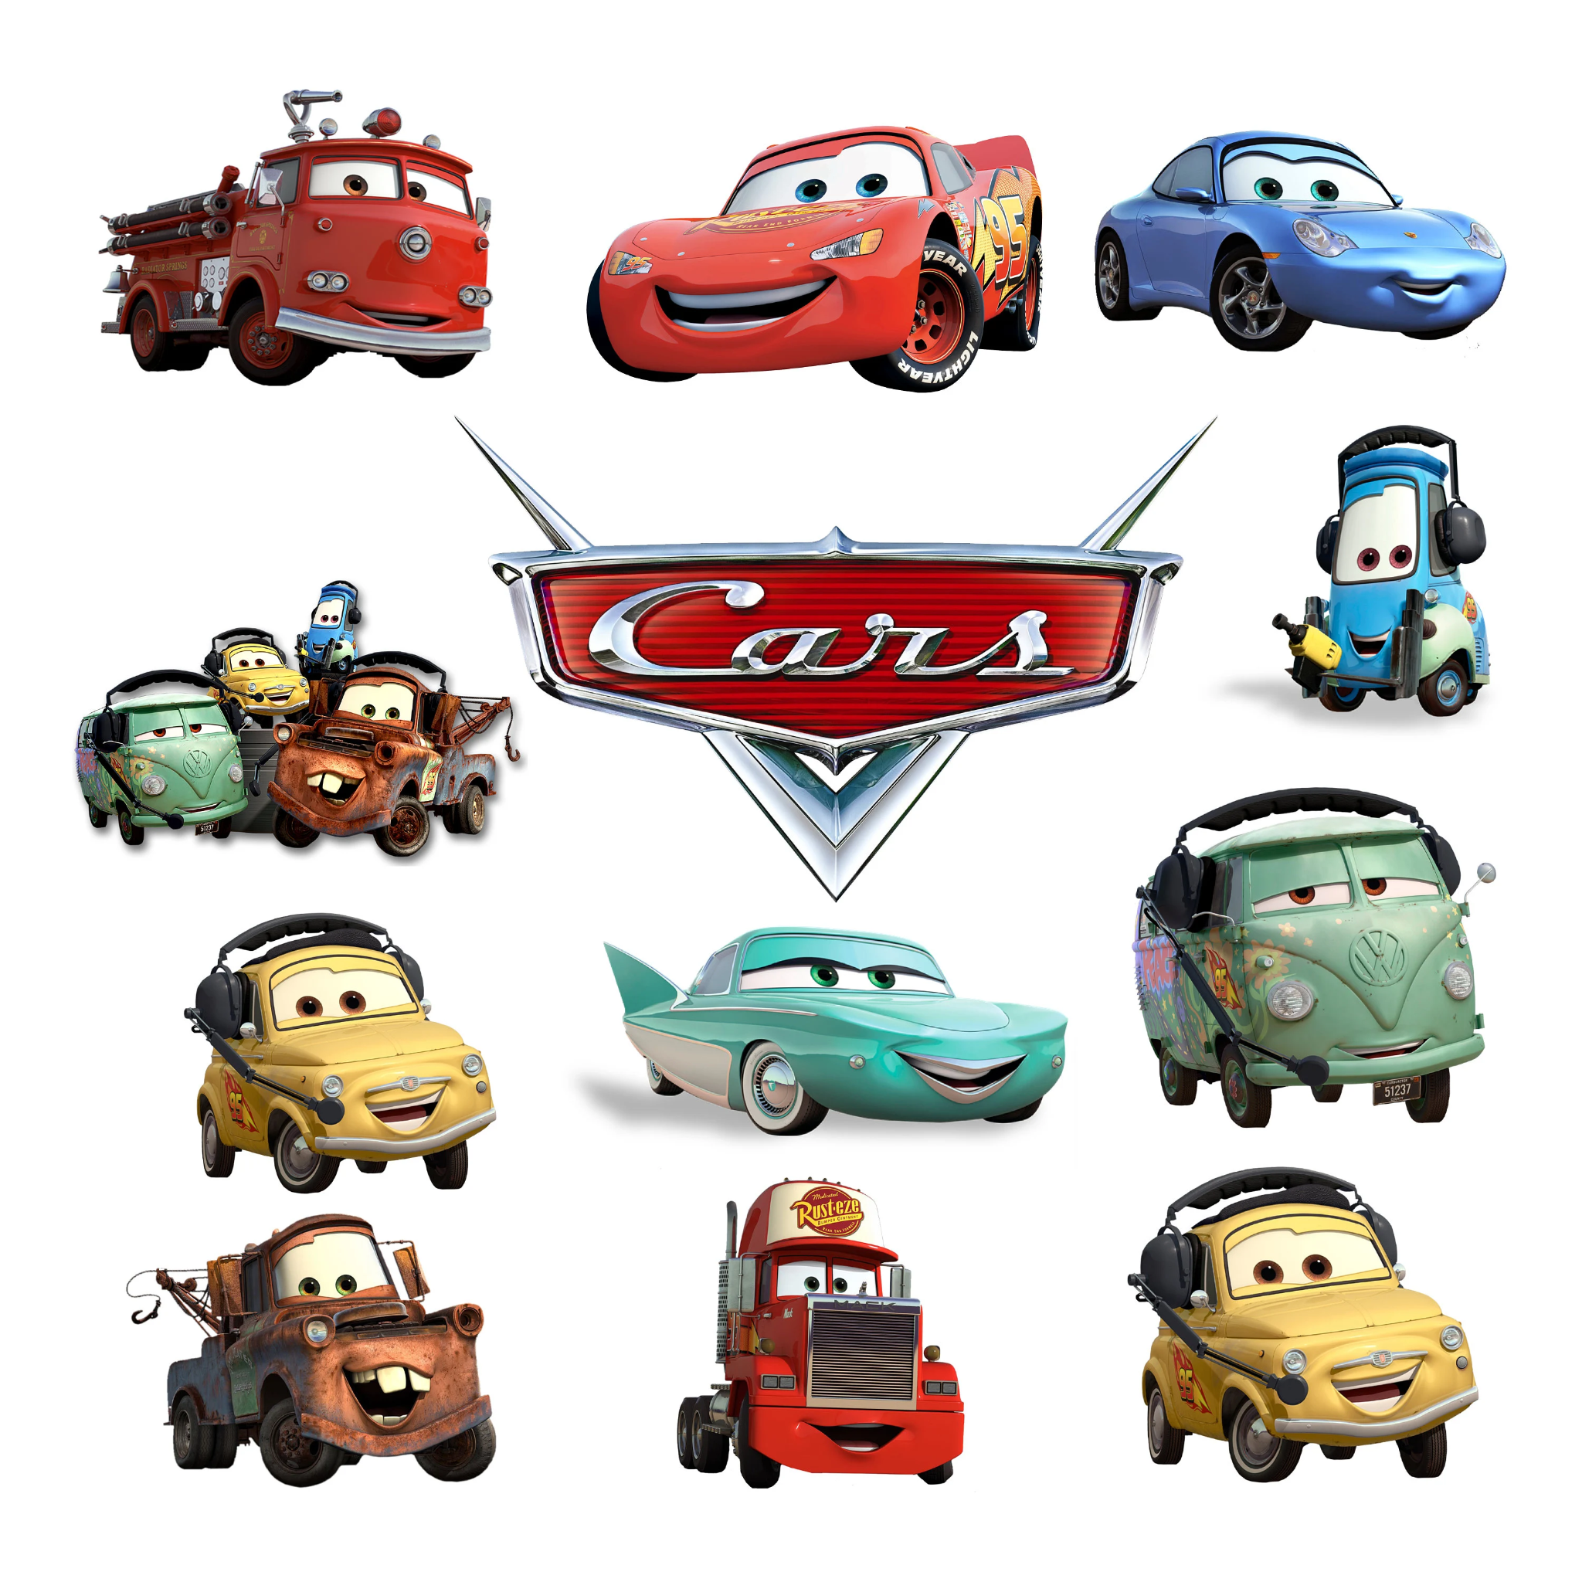
What is Machine Learning?
But as human beings they all can observe and learn, Let’s show them cars…

Slide 9
What is Machine Learning?
Let’s ask the same question the same question again…
What is this object ?
Do you think they can answer it?

Slide 10
What is Machine Learning?
Certainly they cannot, because…
Car
It is a car???
Goo goo gaa gaa brum brum :)

Slide 11

What is Machine Learning?
Now what about machine?
Machines follow instructions
We can ask machines to perform arithmetic computations / calculations
And More complex tasks.
Can we make machines behave like humans?

Slide 12
What is Machine Learning?
Can we make machines behave like humans?
Yes, just like what we did to humans, we need to provide experience to machines.
How do we do that?

Slide 13


What is Machine Learning?
Can we make machines behave like humans?
Data
Algorithms

Slide 14
What is Machine Learning?
What are the qualities of good data ?
Accuracy - Data must be free from errors and inconsistencies to ensure algorithms learn from reliable source
Completeness - Data should contain all the necessary information to address the problem being solved, including handling missing values.
Reliability - Data should be consistent and trustworthy, meaning it can be depended upon to represent the real world.
Relevance - The data should be directly related to the problem being addressed.
Timeliness - The data should be current and reflect the latest information to ensure model’s predictions are accurate.
Diversity - The dataset should include a variety of examples to help model learn from different scenarios and generalize well to unseen data.
Data

Slide 15
What is Machine Learning?
What are the qualities of good data ?
Representativeness - The data should be representative of the target population or scenario to avoid bias and ensure the model's predictions are applicable.
Quantity - A large enough dataset is needed to train the model effectively and capture complex patterns.
Consistency - Data should be formatted consistently across all samples, ensuring the model learns from reliable data.
Labeling - In supervised learning, data should be properly labeled or annotated to teach the model how to recognize outcomes.
Cleanliness - Data should be free from errors, inconsistencies, and irrelevant information through processes like data cleaning.
Data

Slide 16
What is Machine Learning?
What these ML algorithms do?
These algorithms are meant to execute programs on the data, with respect to the underlying tasks
Programs to:
Identify required rules
Extract patterns
Extract features
Identify relations
So later, we can use whatever programs learnt to make predictions/inference…
Algorithms

Slide 17
What is Machine Learning?
In Summary (Given a machine learning task) …
Identify and create appropriate datasets
Apply relevant algorithm train a best model, which will
Learn/extract rules, features or patterns
Output the decision (prediction)
Algorithms

Slide 18
Rule Based Systems vs ML Systems
If it is a rule based system we will have rules
x1: year of manufacture
x2: year of registered
x3: number of previous owners
x4: mileage / odometer reading
x5: mileage per litre of fuel
x6: number of previous accidents
x7: vehicle color
x8: country of origin
x9: make
x10: interior condition (good/ok/bad)
And many more…

Slide 19
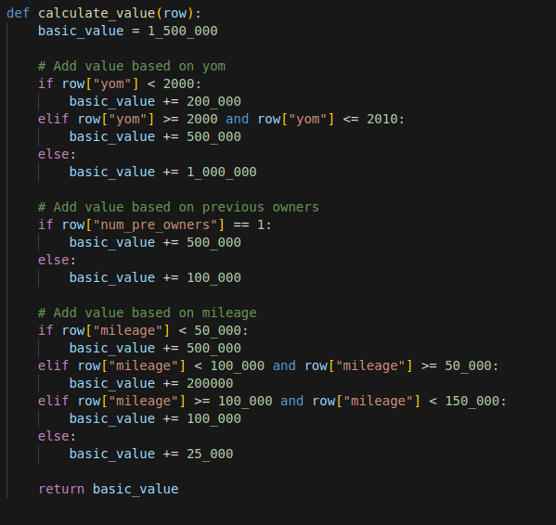
Rule Based Systems vs ML Systems
Let’s consider a car price prediction system, how would we predict the price?
Considering only three features…

Slide 20
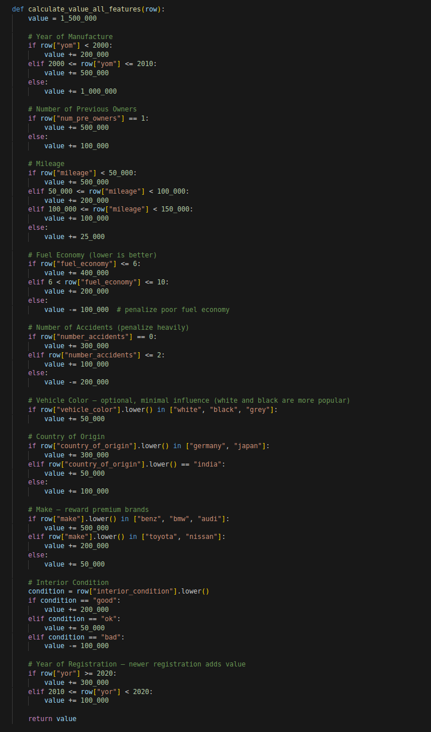
Rule Based Systems vs ML Systems
Let’s consider a car price prediction system, how would we predict the price?
Considering all the features we declared…
Oops, what if we have more features? And what we always find new features to consider?

Slide 21
Rule Based Systems vs ML Systems
Software
Data
Output
Code
Hardcoded rules in software system
At some point this system becomes difficult to maintain

Slide 22
Rule Based Systems vs ML Systems
Software
Data
Model
Output
The algorithms learn from data and corresponding labels/outcomes
Then we can use the model to predict output for unseen data points

Slide 23
Machine Learning Paradigms
Supervised Learning
Unsupervised Learning
Reinforcement Learning
Semi-supervised Learning
Self-supervised Learning

Slide 24
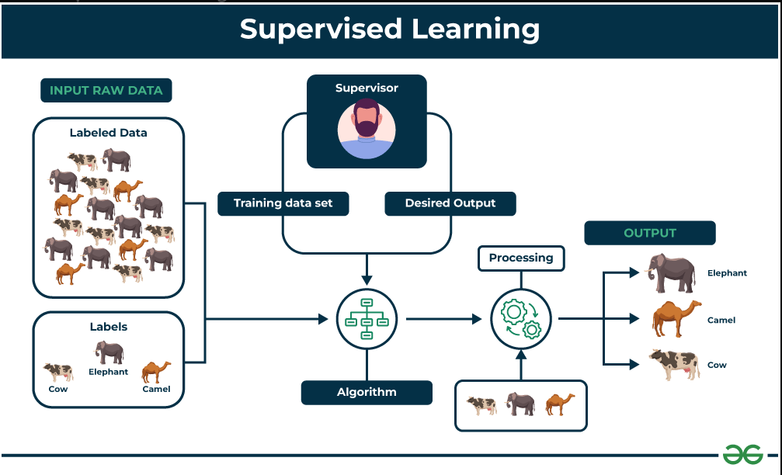
Machine Learning Paradigms
Supervised Learning
Image Ref: https://www.geeksforgeeks.org/supervised-unsupervised-learning/?utm_source=chatgpt.com

Slide 25
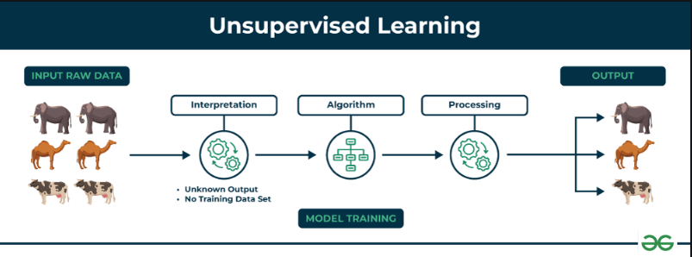
Machine Learning Paradigms
Unsupervised Learning
Image Ref: https://www.geeksforgeeks.org/unsupervised-learning/

Slide 26
Machine Learning Paradigms
Unsupervised Learning
Input Raw Data
Description: The data consists of different animals like elephants, camels, and cows.
Key Point: There are no labels provided (e.g., "Elephant", "Camel", "Cow"). The model sees only the raw features (e.g., size, shape, color).
Interpretation
Description: The model begins interpreting the input data.
Key Point: The system starts identifying patterns, similarities, or structures in the data.
Note: There is no training dataset or known output. It learns solely from the data's internal structure.
Algorithm
Description: A clustering or dimensionality reduction algorithm is applied.
Example Algorithms:
K-Means Clustering
Hierarchical Clustering
DBSCAN
PCA (Principal Component Analysis) for dimensionality reduction
Key Point: The algorithm groups the data into clusters based on similarities.

Slide 27
Machine Learning Paradigms
Unsupervised Learning
Processing
Description: The data is processed based on the patterns or clusters discovered.
Outcome: Data points that are similar are grouped together, forming distinct clusters.
Interpretation
Description: The model begins interpreting the input data.
Key Point: The system starts identifying patterns, similarities, or structures in the data.
Note: There is no training dataset or known output. It learns solely from the data's internal structure.
Output
Description: The final output consists of categorized groups, such as one group of elephants, another of camels, and another of cows.
Key Point: : Even though the categories (e.g., animal types) were not known in advance, the model successfully grouped similar data points.

Slide 28
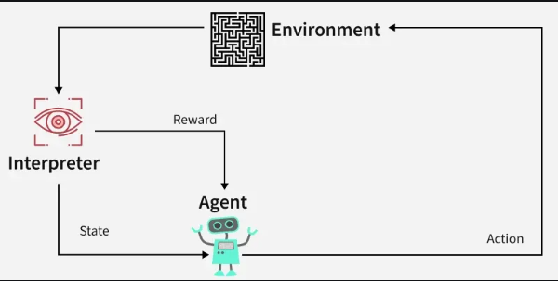
Machine Learning Paradigms
Reinforcement Learning
Image Ref: https://www.geeksforgeeks.org/what-is-reinforcement-learning/

Slide 29
Machine Learning Applications
🔍 1. Healthcare
Disease Diagnosis: Detecting diseases like cancer, diabetes, or heart conditions from imaging or lab data.
Medical Imaging: Identifying anomalies in X-rays, MRIs (e.g., brain tumors using CNNs).
Drug Discovery: Predicting molecular behavior and drug-target interactions.
Personalized Treatment: Tailoring therapies based on genetic data and patient history.

Slide 30
Machine Learning Applications
💰 2. Finance
Fraud Detection: Identifying fraudulent transactions using anomaly detection.
Credit Scoring: Assessing loan eligibility using historical credit behavior.
Algorithmic Trading: Making high-frequency trading decisions based on market trends.
Risk Management: Forecasting portfolio risk and insurance claims.

Slide 31
Machine Learning Applications
🛒 3. Retail & E-Commerce
Recommendation Systems: Like those used by Amazon or Netflix to suggest products.
Customer Segmentation: Clustering customers for targeted marketing.
Inventory Management: Demand forecasting for supply chain optimization.
Price Optimization: Dynamic pricing using real-time demand and competition data.

Slide 32
Machine Learning Applications
🏭 4. Manufacturing & Industry
Predictive Maintenance: Anticipating equipment failures using sensor data.
Quality Control: Detecting defects in production lines using computer vision.
Process Optimization: Improving resource utilization and throughput.

Slide 33
Machine Learning Applications
🚗 5. Autonomous Systems
Self-Driving Cars: Perceiving the environment and making driving decisions.
Drones & Robotics: Real-time navigation and object manipulation.

Slide 34
Machine Learning Applications
💬 6. Natural Language Processing (NLP)
Speech Recognition: Used in assistants like Siri or Google Assistant.
Text Summarization & Translation: Automatically summarizing or translating documents.
Sentiment Analysis: Understanding public opinion from reviews or social media.

Slide 35
Machine Learning Applications
🖼️ 7. Image & Video Processing
Facial Recognition: For security and identity verification.
Object Detection & Tracking: In surveillance, retail analytics, etc.
Augmented Reality: Enhancing user environments in real time.

Slide 36
Machine Learning Applications
🌐 8. Cybersecurity
Threat Detection: Identifying malware or intrusion attempts.
Behavioral Biometrics: Analyzing keystroke dynamics or mouse movement for authentication.

Slide 37
Machine Learning Applications
📈 9. Marketing & Customer Analytics
Churn Prediction: Identifying users likely to stop using a product.
Ad Targeting: Delivering ads based on user behavior and preferences.

Slide 38
Machine Learning Applications
🌍 10. Environmental Science & Agriculture
Climate Modeling: Predicting weather patterns and environmental changes.
Crop Monitoring: Using satellite data to assess crop health.
Wildlife Conservation: Tracking animal populations and movement via ML-based sensors.

